Slide 1
Solving Equations
Variables on both sides and Word Problems

Slide 2
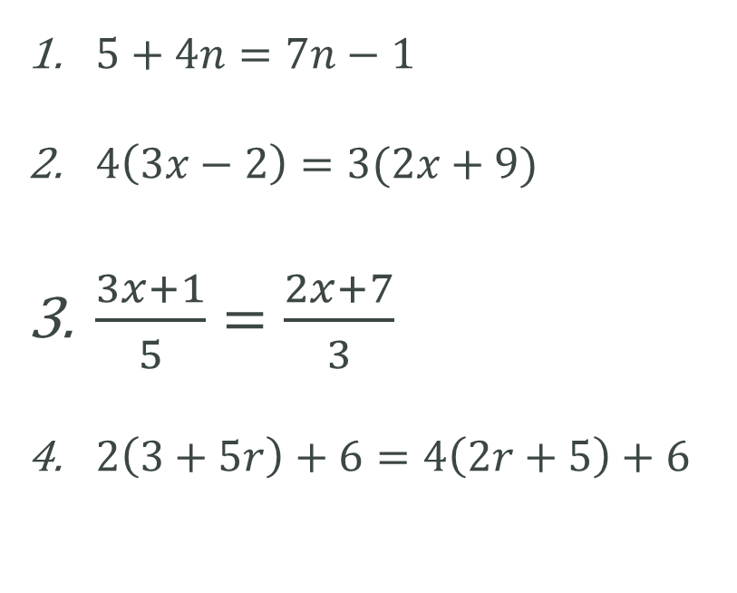

Set 1 Set 2
$5+4n=7n−1$
$4\left(3x−2\right)=3(2x+9)$
$\frac{3x+1}{5}=\frac{2x+7}{3}$
$2\left(3+5r\right)+6=4\left(2r+5\right)+6$
$14−5x=5−2x$
$7\left(x+4\right)=3\left(x−4\right)$
$\frac{5x+1}{3}=\frac{5x−2}{4}$
$3\left(4h+5\right)+2=14+3(5h−2)$
Notes:
Assign students sitting next to each other as 1 and 2. Students with 1 will do set 1 and students with 2 will do set 2. Once finished (10 mins) pass your working to a person in another group, check each others working and provide feedback.

Slide 3
Worded Problem – Round Tables
Select a group of 3 to work in.
Person 1 – Establish Variable (writing the “let” statement) and write an equation based on the information given.
Person 2 – Solves equation
Person 3 – Checks the solution, substitute the solution back into the “let statements and present a final solution
Pass the problem to next group.
First Group to answer all 6 questions will get VIVO Points.

Slide 4
Reflection - Closure
What did you learn about working collaboratively?
What are your strengths?
What are your weaknesses?
Complete 24/7/30 and summaries.

